Slide 1
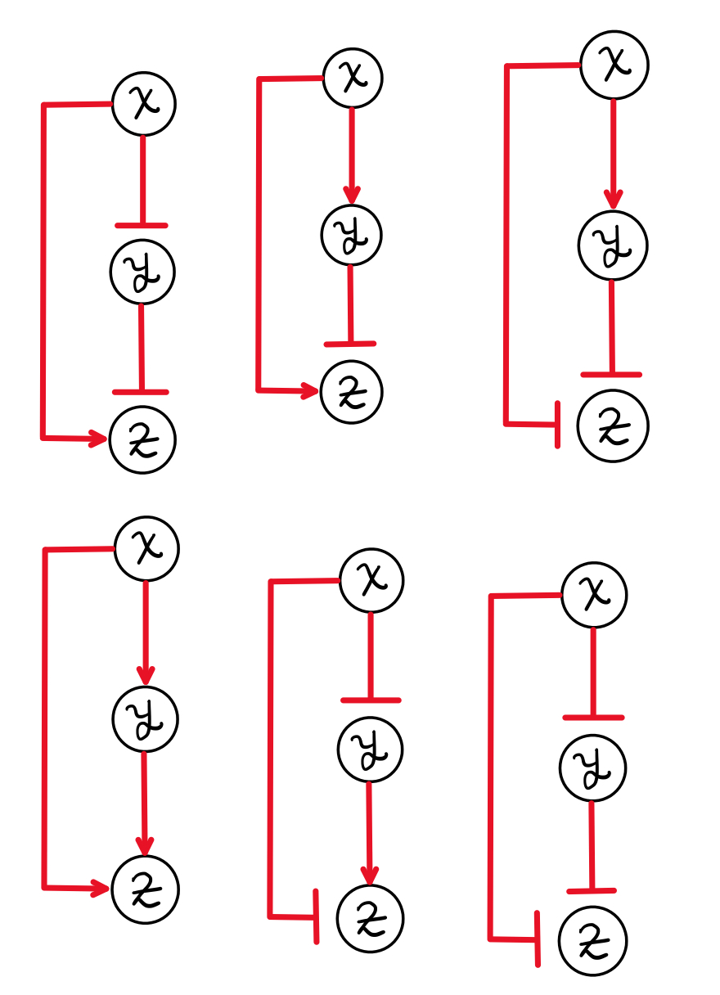
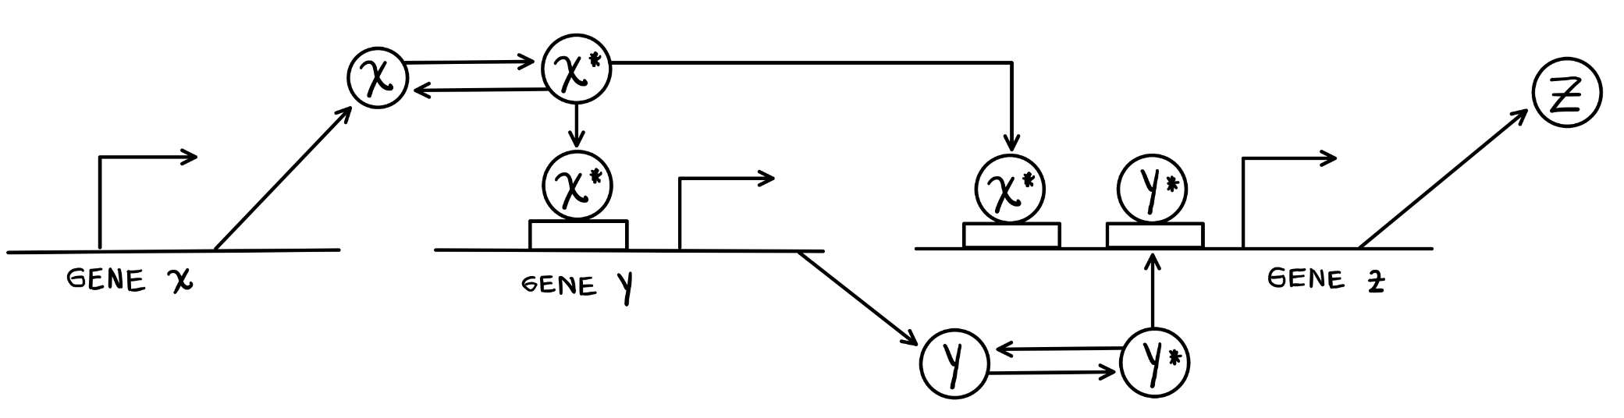

Health, mortality and Human Aging
Rafael Enrique Velásquez Rojas

Slide 2
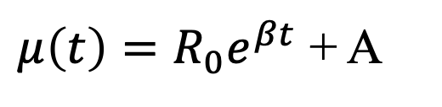
Gompertz Law to model the exponential increment
$μ\left(t\right)=R_{0}e^{βt}$ + A
Exponential model to explain the exponential increment of mortality with age
Sum of age dependent term and age independent term
Slide 3
Notes:
Some population there are described by high age independent death rates

Slide 3
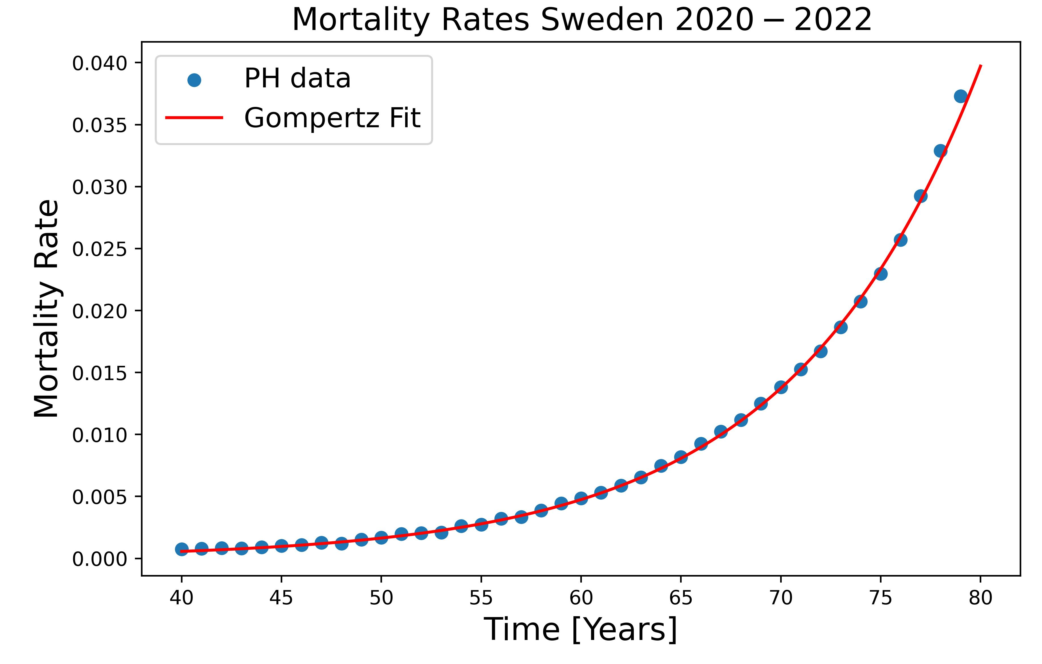
Gompertz Law to model the exponential increment
$μ\left(t\right)=R_{0}e^{βt}$ + A
Exponential model to explain the exponential increment of mortality with age
Sum of age dependent term and age independent term
Slide 3
Notes:
Some population there are described by high age independent death rates

Slide 4
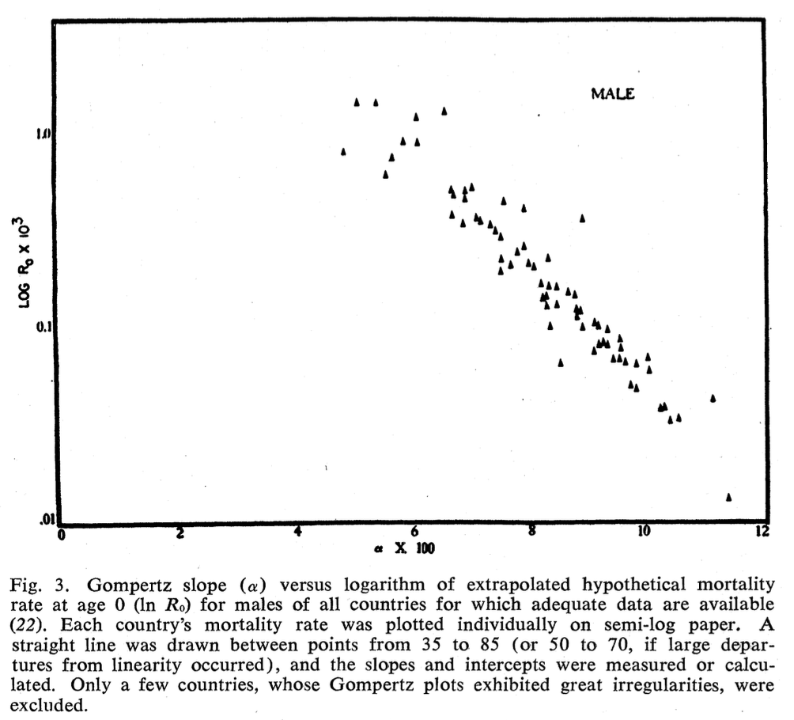
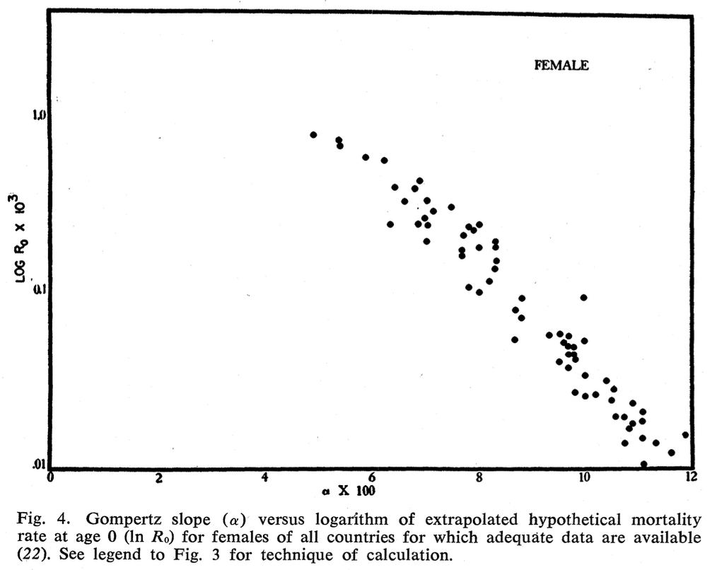
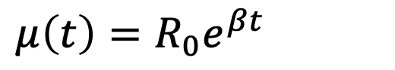
Strehler-Mildvan Correlation
$μ\left(t\right)=R_{0}e^{βt}$
Gompertz Law exponential mortality
Slide 4
Notes:
Some population there are described by high age independent death rates

Slide 5
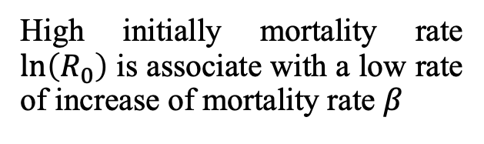
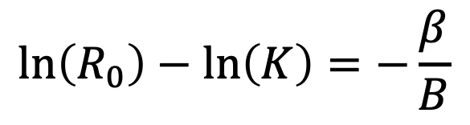
Strehler-Mildvan Correlation
$μ\left(t\right)=R_{0}e^{βt}$
Gompertz Law exponential mortality
$$\ln\left(R_{0}\right)−\ln\left(K\right)=−\frac{β}{B}$$
Correlation between two parameters of Gompertz Law
High initially mortality rate $\ln\left(R_{0}\right)$ is associate with a low rate of increase of mortality rate $β$
Slide 4
Notes:
Some population there are described by high age independent death rates

Slide 6
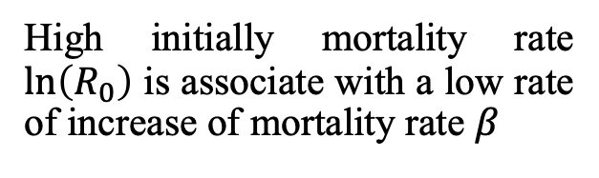
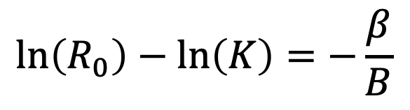
Strehler-Mildvan Correlation
$$\ln\left(R_{0}\right)−\ln\left(K\right)=−\frac{β}{B}$$
High initially mortality rate $\ln\left(R_{0}\right)$ is associate with a low rate of increase of mortality rate $β$
Slide 4
Notes:
Some population there are described by high age independent death rates

Slide 7
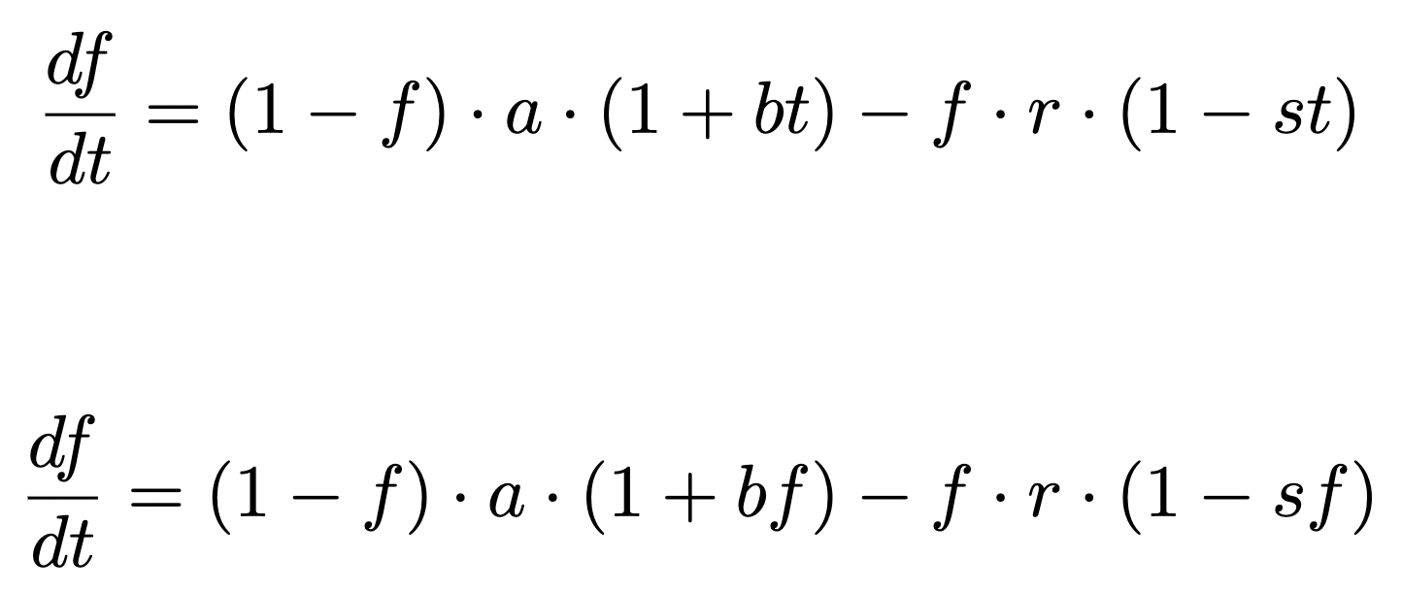
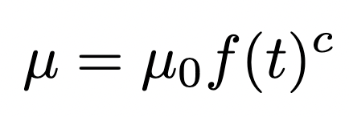
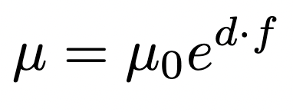
Developing a model for frailty index and mortality
Option 1 for frailty index model
Option 2 for frailty index model
Option 1 for mortality rate model
Option 2 for mortality rate model
Slide 8
Notes:
Some population there are described by high age independent death rates

Slide 8
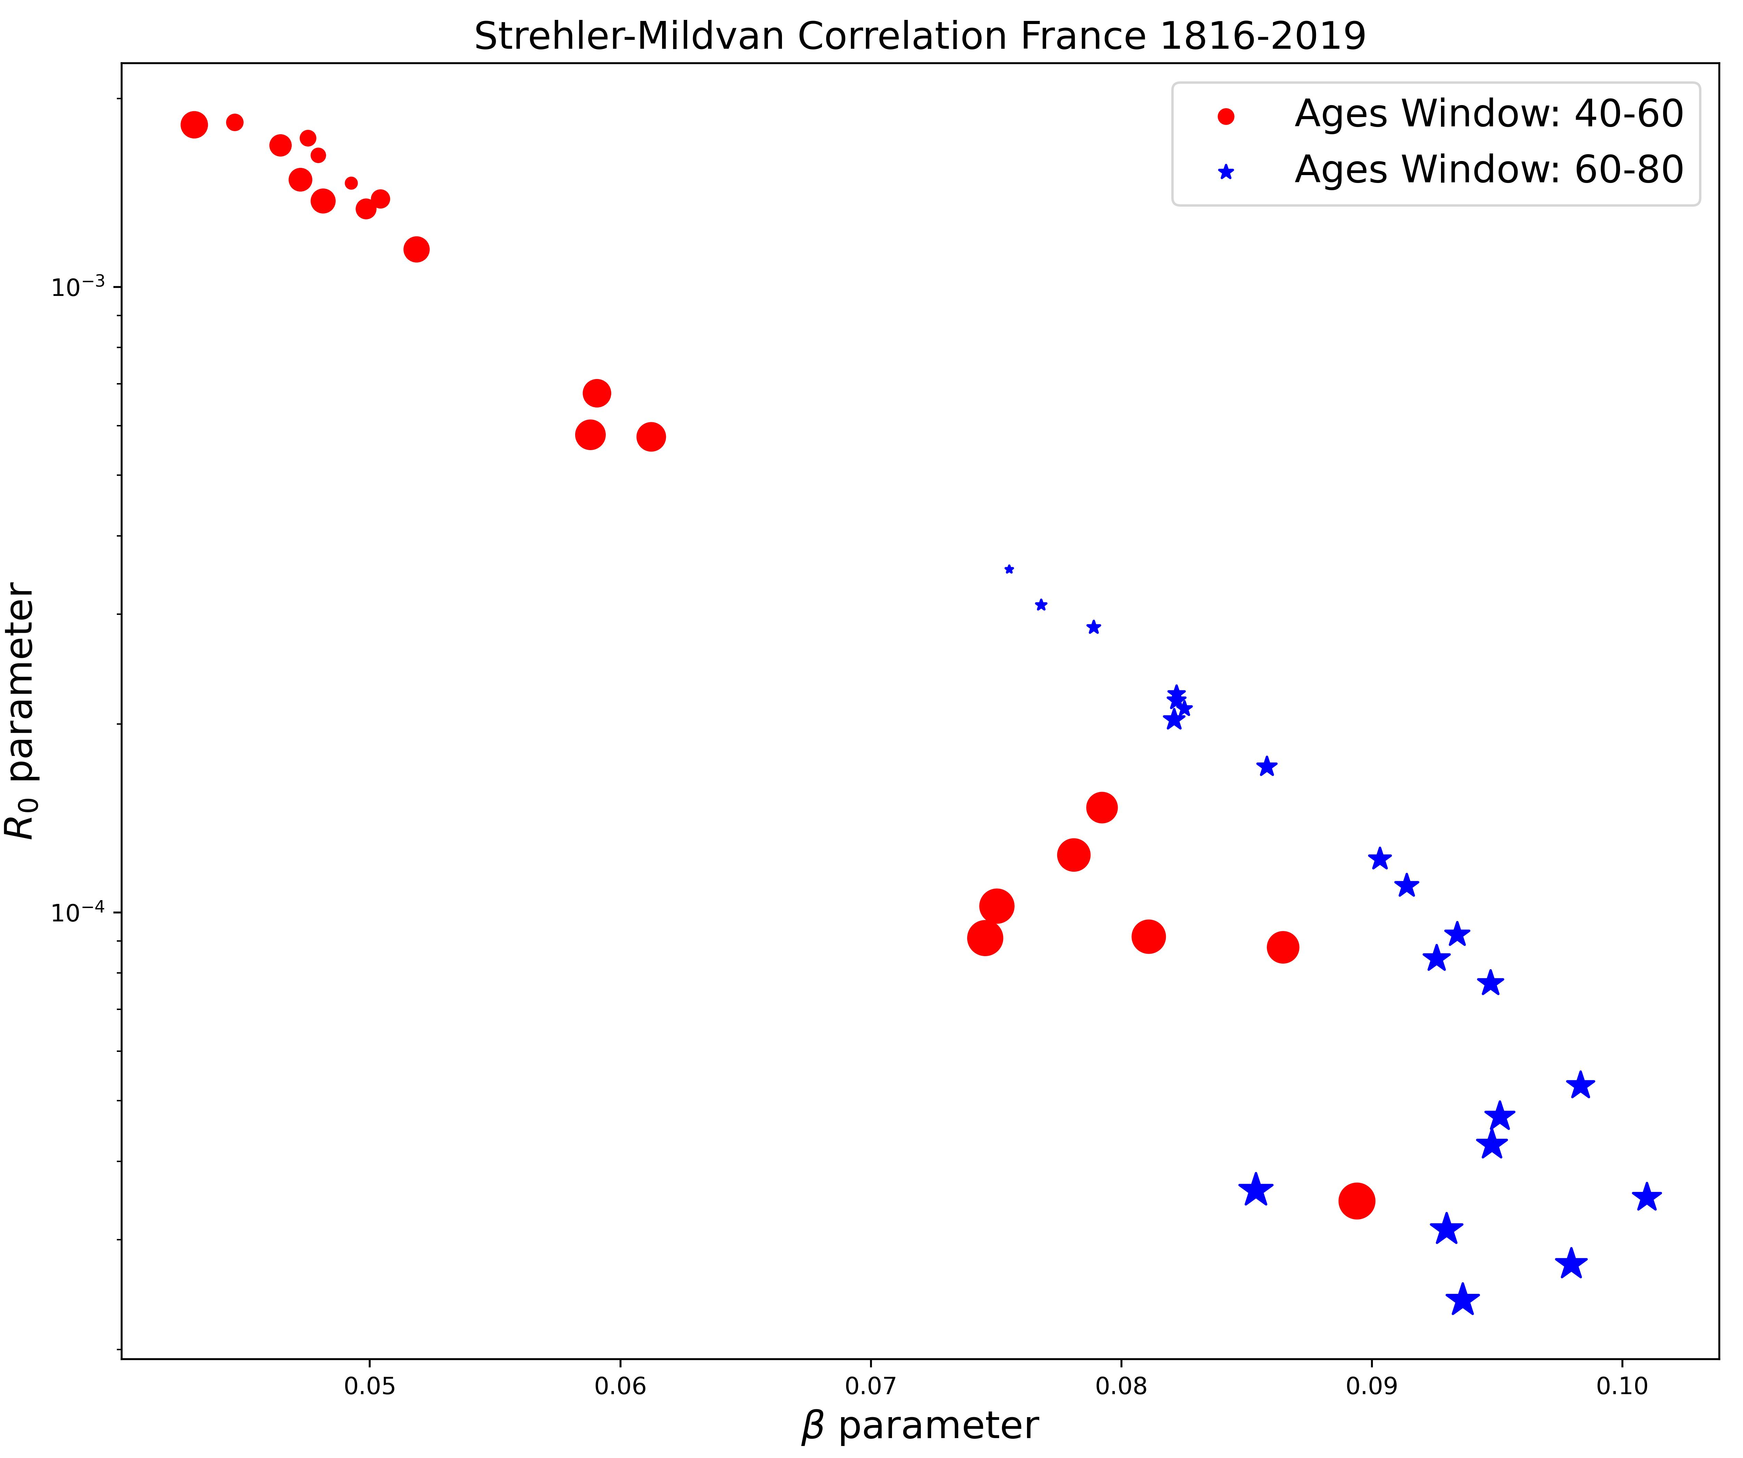
Strehler-Mildvan Correlation phenomenological data
Slide 9

Slide 9
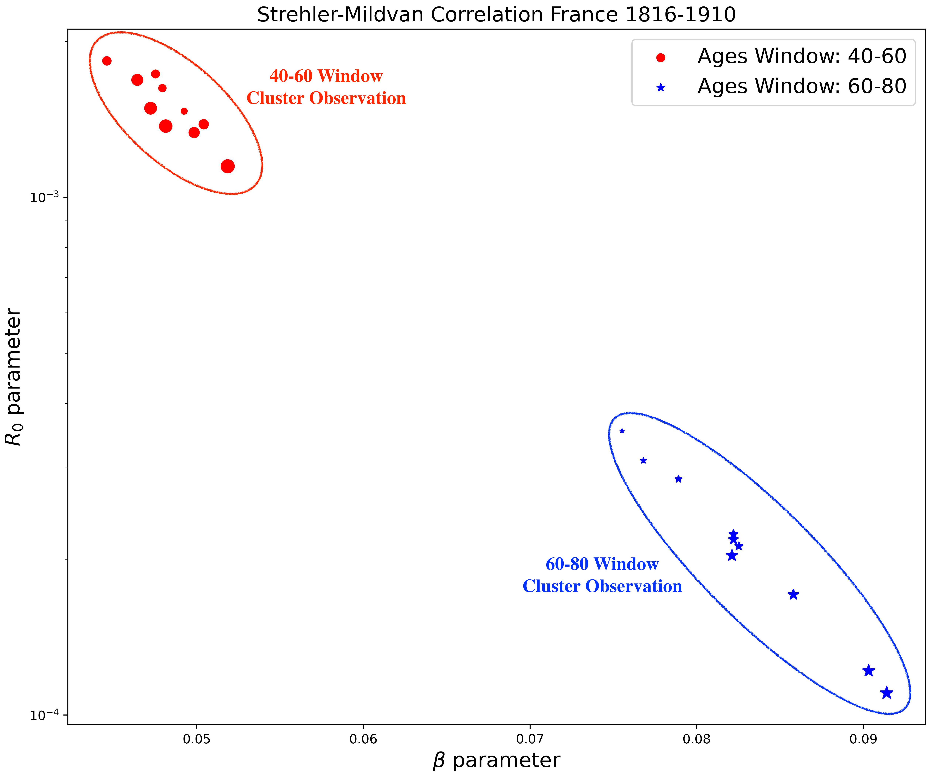
Strehler-Mildvan Correlation phenomenological data
Slide 9

Slide 10
Strehler-Mildvan Correlation phenomenological data
Slide 10

Slide 11
Strehler-Mildvan Correlation phenomenological data
Slide 10

Slide 12
Strehler-Mildvan Correlation phenomenological data
Differences in the correlation between the 40-60 window and the 60-80 window ages.
Slide 10

Slide 13
Strehler-Mildvan Correlation phenomenological data
Differences in the correlation between the 40-60 window and the 60-80 window ages.
Depending on the observation window, there are different values for the parameters of Gompertz’s Law.
Slide 10

Slide 14
Why these proposals for the models?
Slide XXX

Slide 15
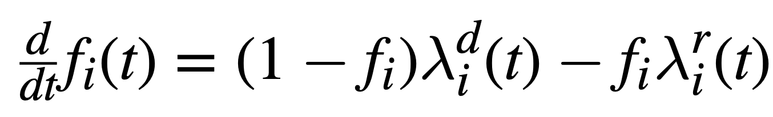
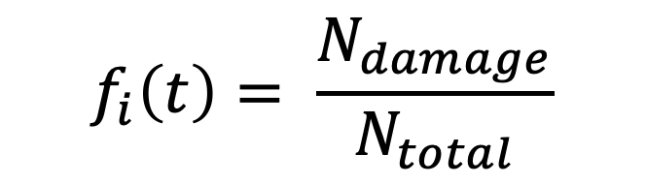


Repair and damages nodes model
$$f_{i}\left(t\right)= \frac{N_{damage}}{N_{total}}$$
$${(1−f}_{i})≝attributes available for damage$$
$$f_{i} ≝attributes available for repair$$
Slide XXX

Slide 16


Connection with our proposed model
Slide 8
Notes:
Some population there are described by high age independent death rates

Slide 17
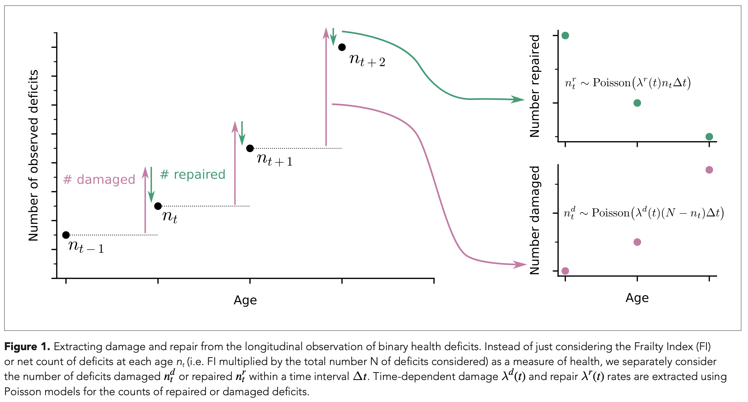
Number of Repaired and Damage Nodes
Slide XXX

Slide 18
Number of Repaired and Damage Nodes
This is the behavior of the repair and damage rates that we need to obtain the desired behavior for the model.
Slide XXX

Slide 19
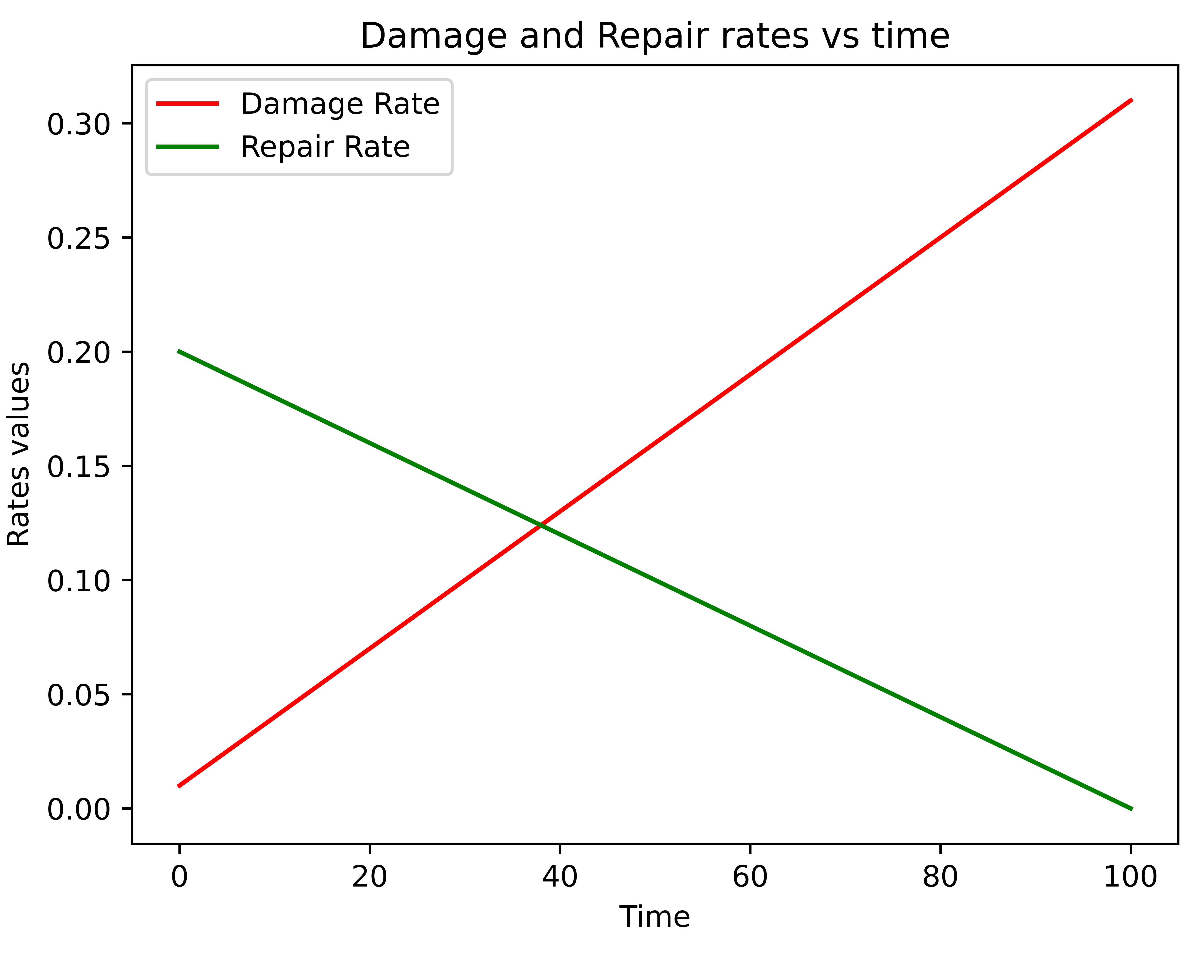
Number of Repaired and Damage Nodes
This is the behavior of the repair and damage rates that we need to obtain the desired behavior for the model.
Slide XXX

Slide 20
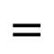
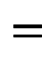
Number of Repaired and Damage Nodes
$$=$$
Damage rate function
$$=$$
Repair rate function
This is the behavior of the repair and damage rates that we need to obtain the desired behavior for the model.
Slide XXX

Slide 21
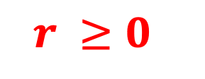
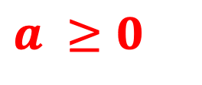
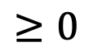
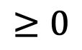
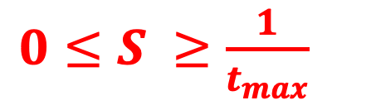
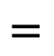
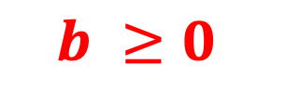
Guesses for the parameters
1) Both the repair and damage rate must be positive for all times.
$$=$$
$$≥0$$
$$=$$
$$≥0$$
$$a ≥0$$
$$b ≥0$$
$$r ≥0$$
$0≤S ≥\frac{1}{t_{max}}$
Slide XXX

Slide 22
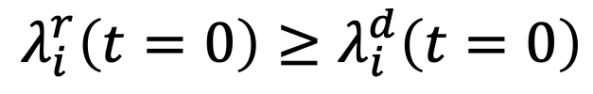
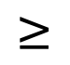
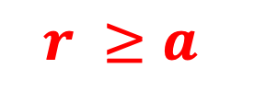
Guesses for the parameters
2) The rate of repair should be greater than the rate of damage at the onset of age.
At least a t = 0
Why?
$$λ_{i}^{r}\left(t=0\right)≥λ_{i}^{d}\left(t=0\right)$$
$$≥$$
$$r ≥a$$
Slide XXX

Slide 23
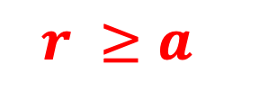
Guesses for the parameters
2) The rate of repair should be greater than the rate of damage at the onset of age.
At least a t = 0
Why?
$$r ≥a$$
Slide XXX

Slide 24
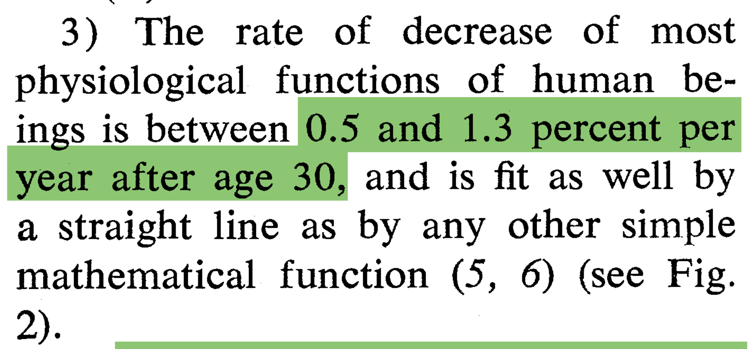
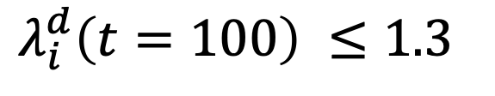
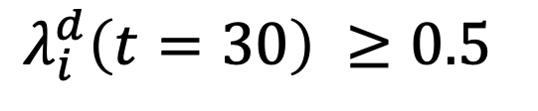
Guesses for the parameters
3) The rate of decrease of most physiological functions of humans beings is between 0.5 and 1.3 percent per year (???).
$$λ_{i}^{d}\left(t=30\right) ≥0.5$$
$$λ_{i}^{d}\left(t=100\right) ≤1.3$$
Slide XXX

Slide 25
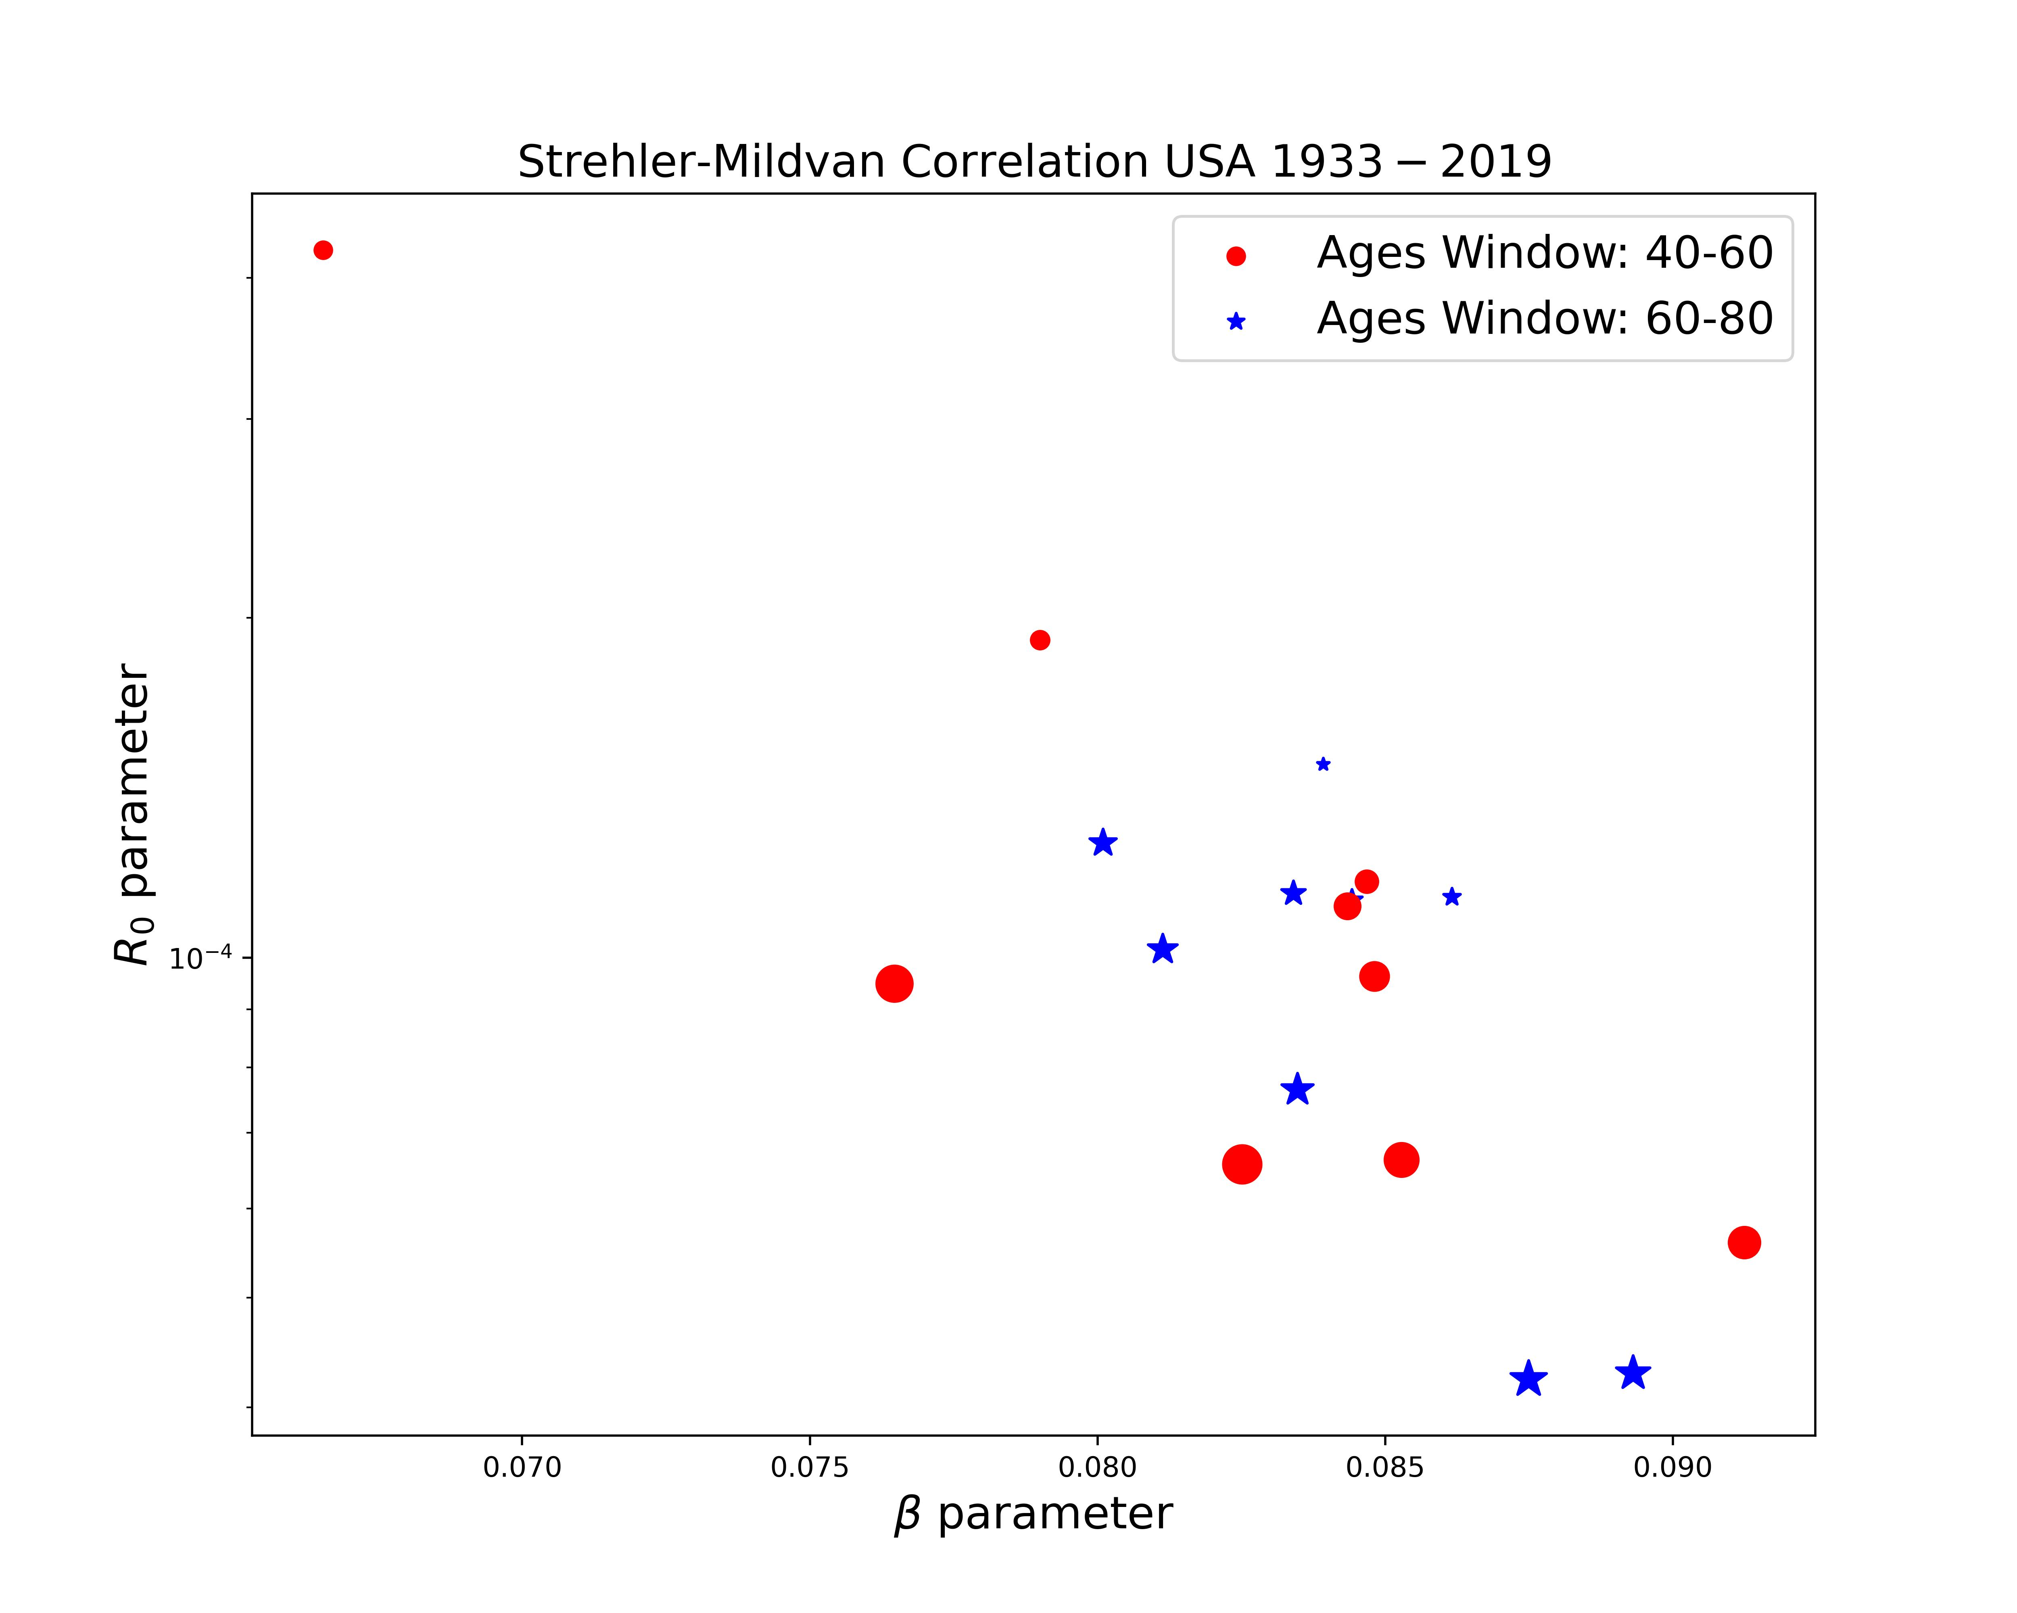

SM correlation is not a strong result

Slide 26
SM correlation is not a strong result
Here we will put results from phenomenological data that shows that Strehler-Mildvan Correlation is not a strong results.
The reason why we cant see the SM correlation as in the paper of 1960 is because:
Gompertz Slope (alpha) could change in the time
Ro could change in the time
Therefore, the correlation between this two values could be dynamic in time and not just one point for the entire curve of mortality rate.
Slide XXX

Slide 27
SM correlation is not a strong result

Slide 28
SM correlation is not a strong result

Slide 29
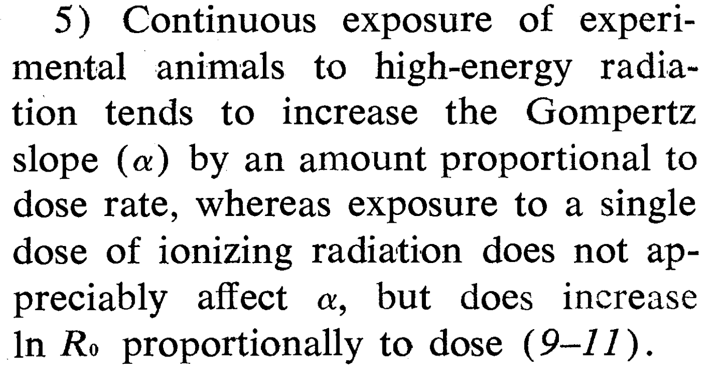



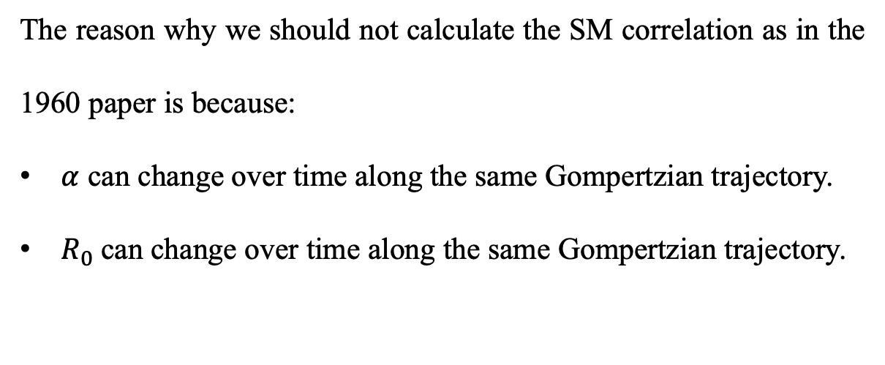




SM correlation is not a strong result (???)
The reason why we should not calculate the SM correlation as in the 1960 paper is because:
$α$ can change over time along the same Gompertzian trajectory.
$R_{0}$can change over time along the same Gompertzian trajectory.
Slide XXX

Slide 30
Model results for SM correlation
Slide XXX

Slide 31
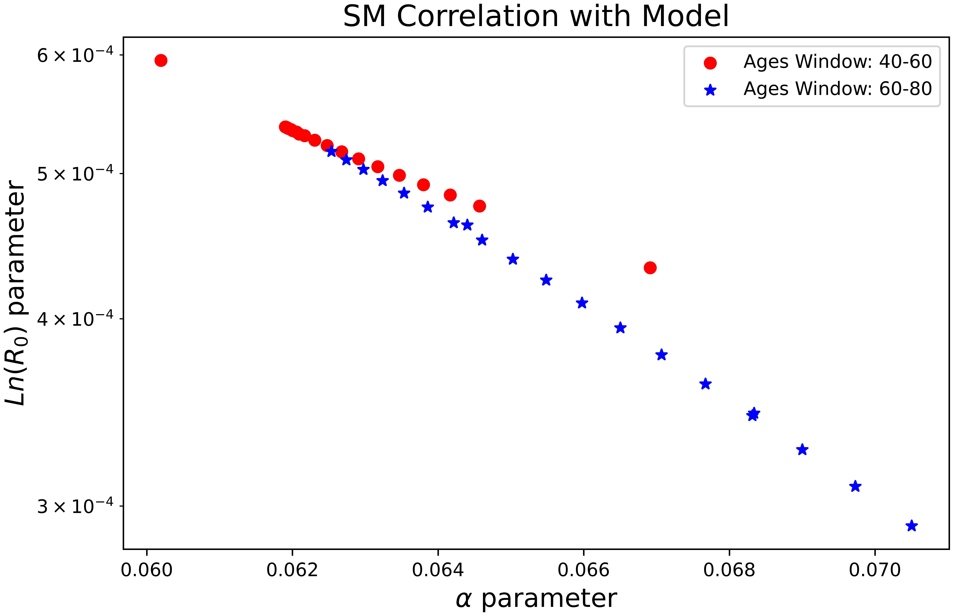
Model results for SM correlation
Slide XXX

Slide 32
Model results for SM correlation
Slide XXX

Slide 33
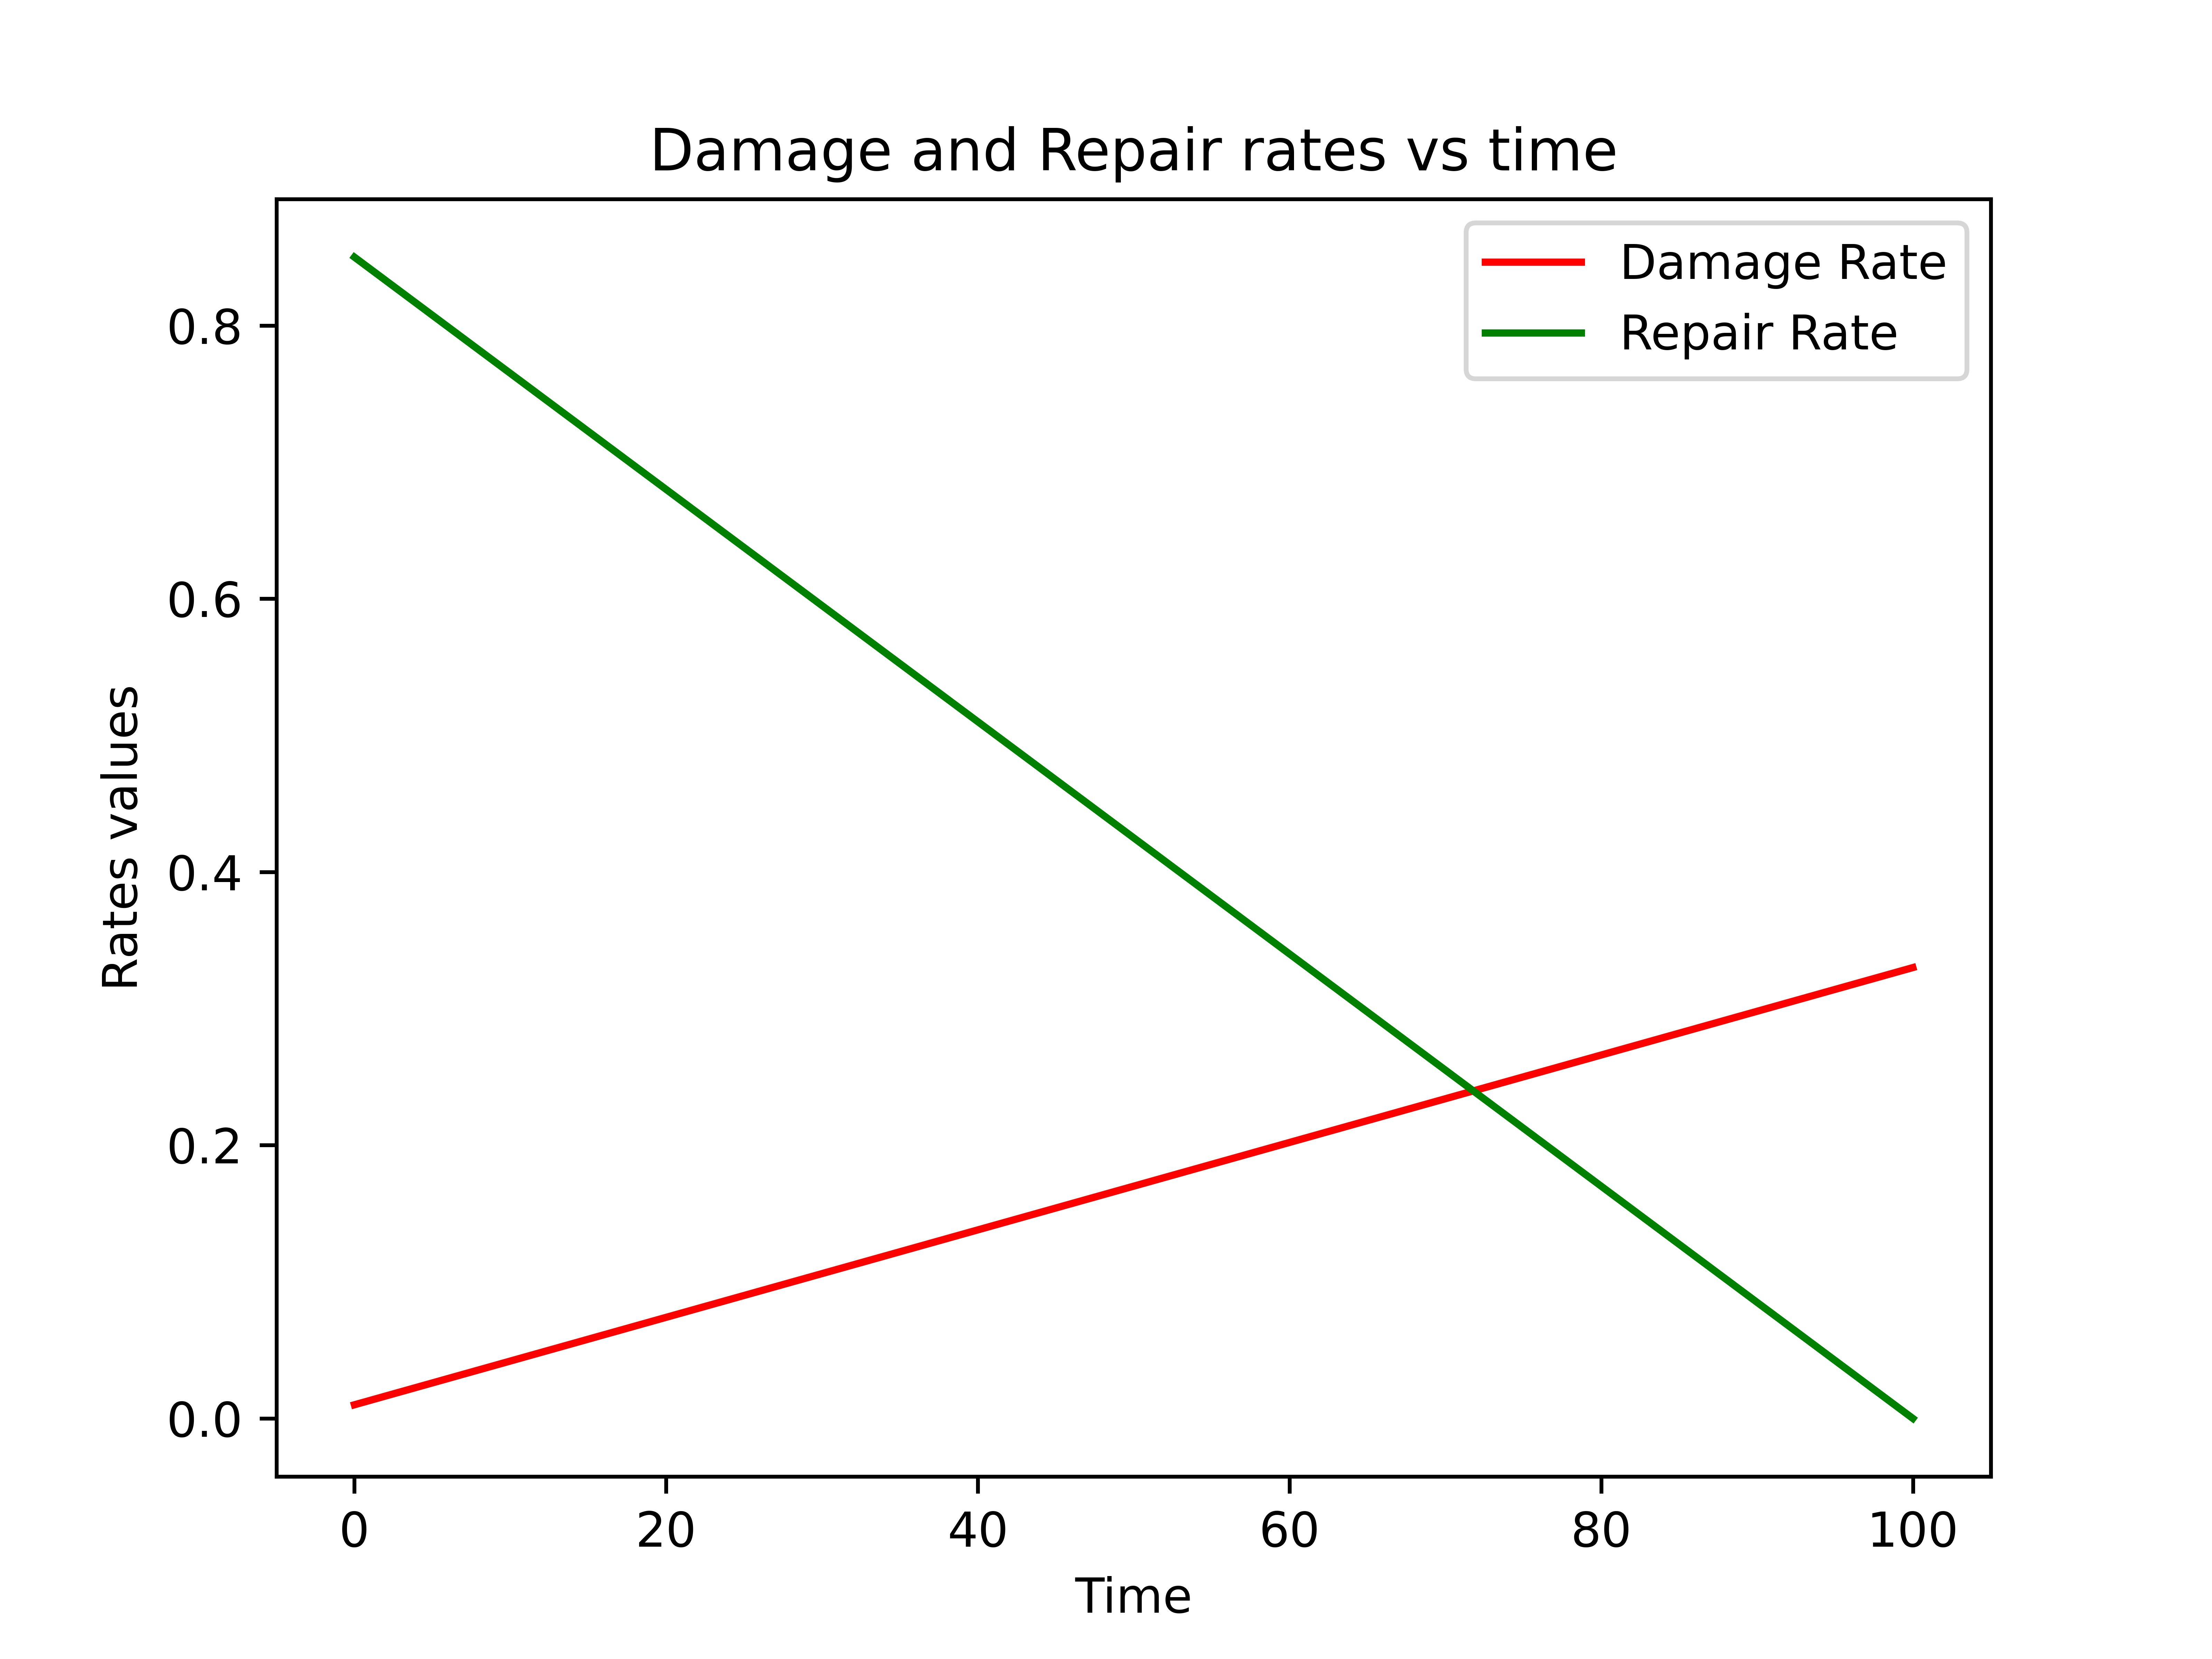
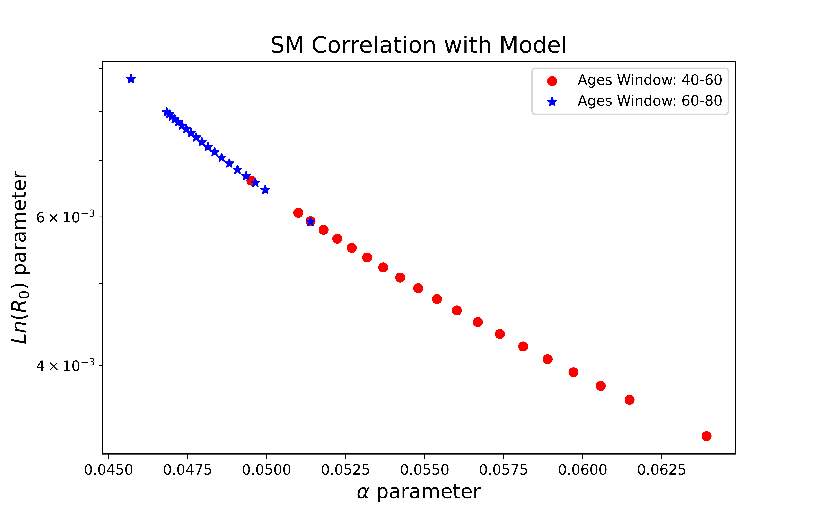
Model results for SM correlation
Slide XXX

Slide 34
Model results for SM correlation
Slide XXX

